Slide 1


Slide 2
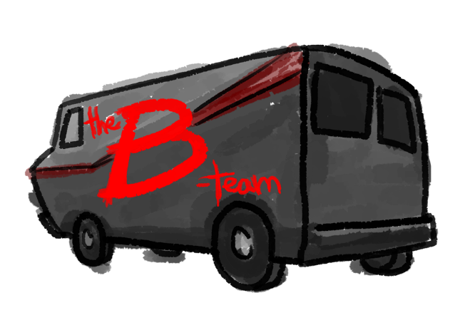

Slide 3
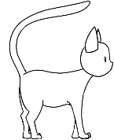

Slide 5
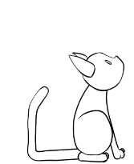
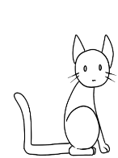

Slide 6
Play
Options
Quit

Slide 7
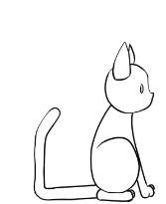
Play
Options
Quit

Slide 8
Play
Options
Quit

Slide 12
mew!

Slide 13

!

Slide 14

Level 1
Level 2
Level 3
Level 4
Level 5
Level 6
Back

Slide 18
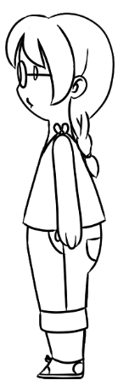


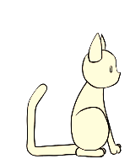
mew!
mew!
mew!
mew!
mew!
mew!
mew!

Slide 19
mew!
mew?
mew!
mew!
mew!
mew!
mew!

Slide 20
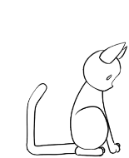

Slide 21
mew?

Slide 25
mew?

Slide 26
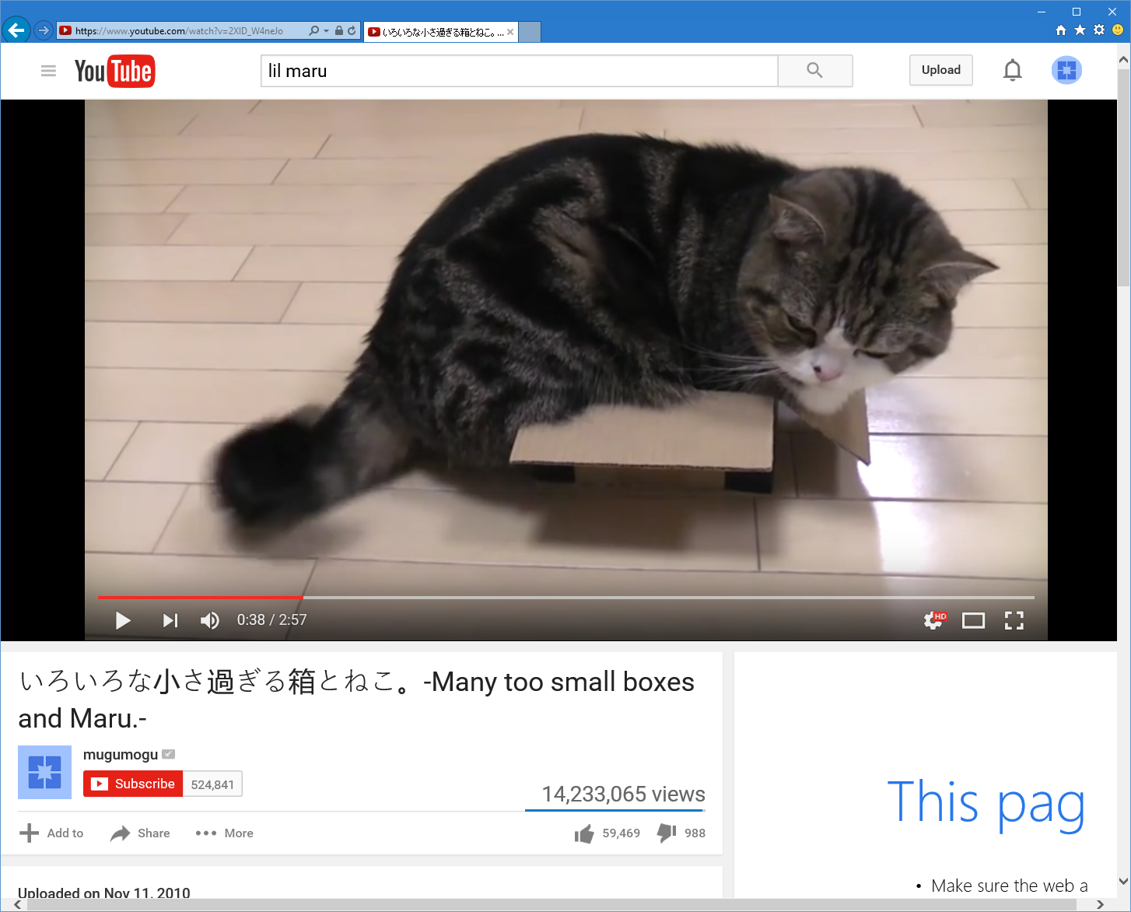

Slide 28
!

Slide 29
mew!

Slide 30
Level 1
Meet Piper
Fame needed


Slide 31
mew!

Slide 34
mew!

Slide 35
!

Slide 36
Mr. Whiskers
accepted your challenge!

Slide 37
Mr. Whiskers thinks you’re okay.
to escape.

Slide 38
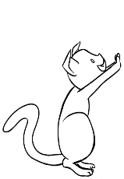
Mr. Whiskers thinks you’re okay.
to escape.

Slide 39

Mr. Whiskers suggests you check yourself before you wreck yourself.
to escape.

Slide 40
Mr. Whiskers has seen better.

Slide 41
Mr. Whiskers is super impressed by your skills!

Slide 42
Mr. Whiskers
joined your posse!

Slide 45
mew!

Slide 46
!

Slide 47
You attracted your human!

Slide 48
Your human thinks you’re okay.
to escape.

Slide 49
The human thinks you’re okay.
to escape.

Slide 50
Your human starts to look bored.
to escape.

Slide 51
Your human has seen better.
You’ll never be famous at this rate!

Slide 52
The human is captivated by your skills.
Get ready to earn some fame!

Slide 53

The human thinks you’re okay.
to escape.

Slide 54
Your human decides not to post anything to YouTube.
You’ll never be famous at this rate!

Slide 55

The human thinks you’re okay.
to escape.

Slide 56


Your human posts its video to YouTube!

Slide 57

Success!!
You’re going to be famous!

Slide 61
mew?

Slide 62
mew
“I’m not going to make it on the outside, man.”

Slide 66
Level 1 Cleared!
Maru | 900 000 000
Grumpy Cat | 800 000 000
Lil Bub | 700 000 000
Colonel Meow | 600 000 000
Marmalade | 500 000 000
Cole | 300 000 000
Hamilton the Hipster | 200 000 000
Venus | 200 000 000
Garfi | 100 000 000
Dancing Piper | 000 000 100
Fame earned

Score earned
000 000 100
Next Level
Menu

Slide 68
